Slide 1

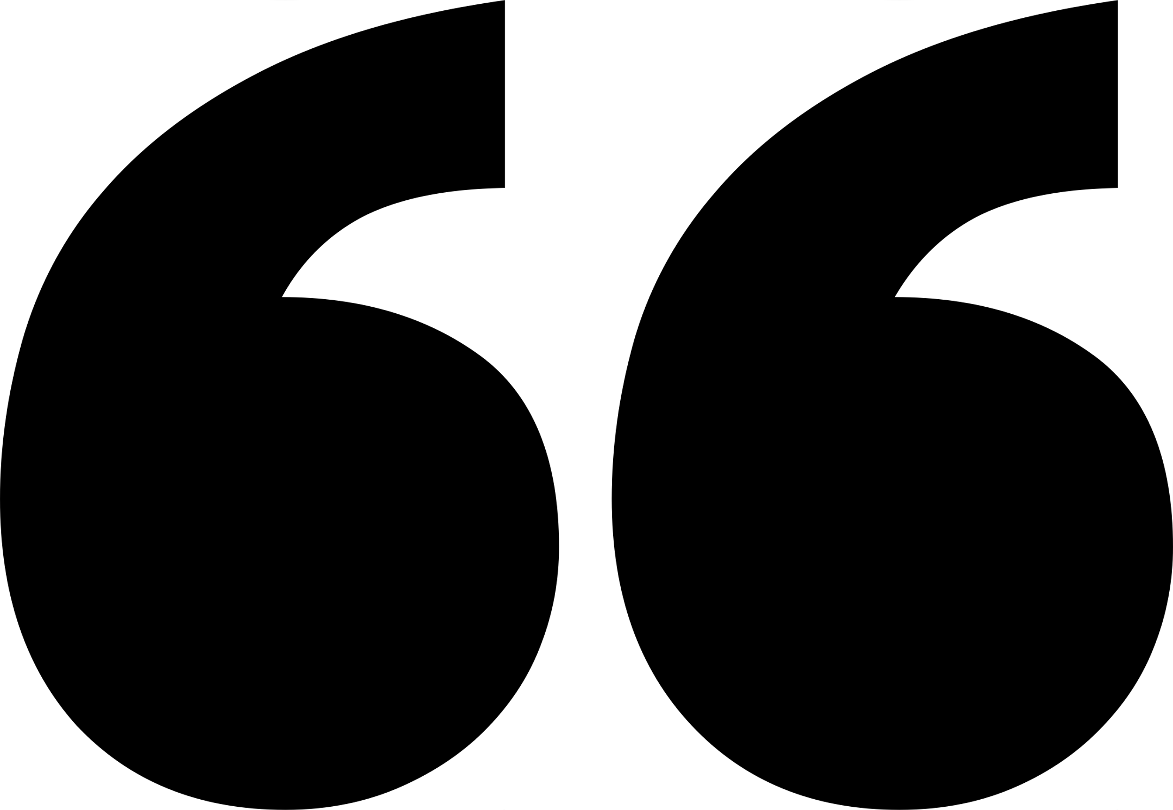
CONFERENCE NAME
PLACE
DATE

Slide 2
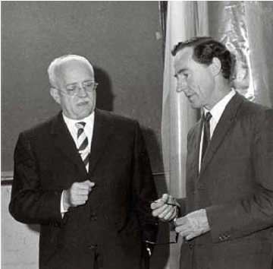
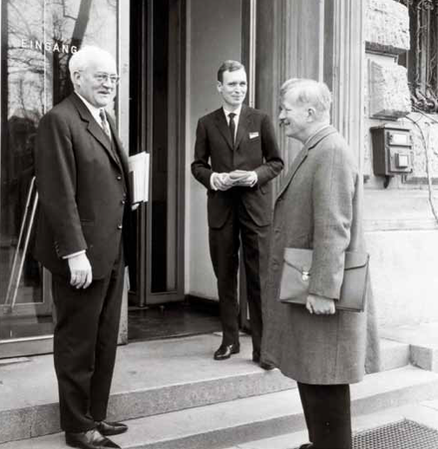
HISTORY
EUROMECH should promote in Europe the development of Mechanics as a fundamental branch of science and engineering.
Founded by George Batchelor and Dietrich Küchemann in 1964. Expanded in 1993 by David Crighton to become the European Mechanics Society.
EUROMECH now has over 3000 active members
G. Batchelor
1st EUROMECH Colloquium (Berlin, 1965). D. Küchemann (right)

Slide 3
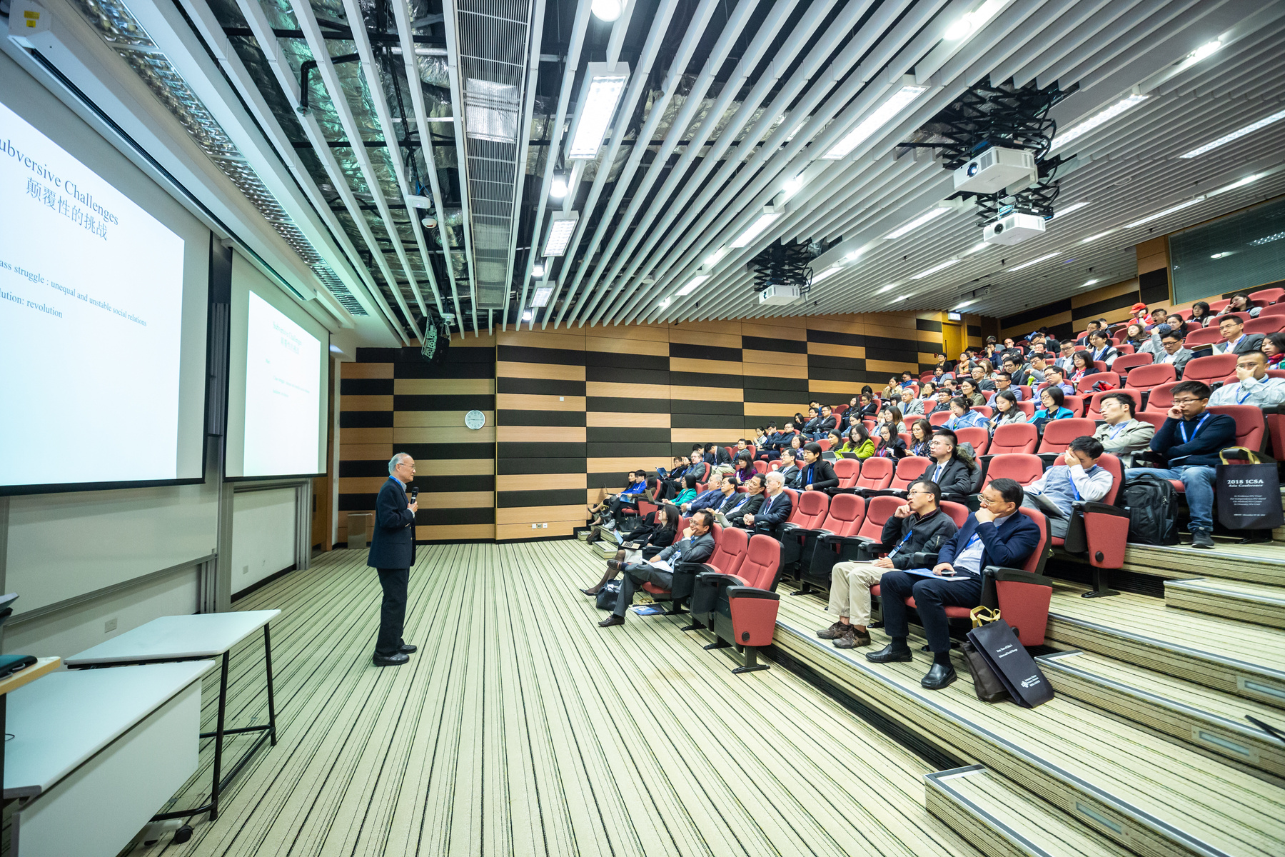
ACTIVITIES
Colloquia (topical workshops)
1
Conferences (thematic conferences)
2
Awards
3
Fellows Fluids/Solids
Prizes Fluids/Solids
Young Scientist Prizes Fluids/Solids

Slide 4
ADVANTAGES OF BEING EUROMECH MEMBER
EUROMECH is an organization driven by members and serving its members
01
02
03
04
organize its events serving the scientific Mechanics community.
participate in EUROMECH colloquia at a reduced fee
use of the organization’s network for announcing events of affiliated organizations.
can be nominated for a EUROMECH award
06
07
08
receive the EUROMECH newsletter with relevant information on the society and its members
fees are paid through conferences, colloquia, affiliated organizations or through individual contributions
Young members are eligible for financial support to attend EUROMECH events

Slide 5

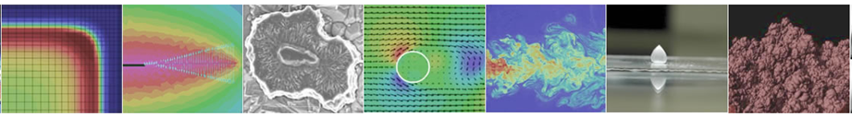
COLLOQUIA
approximately 10 per year
informal meetings on specialized research topics
€ 2.000 seed money contribution from EUROMECH
40 to 70 researchers invited
no proceedings necessary

Slide 6
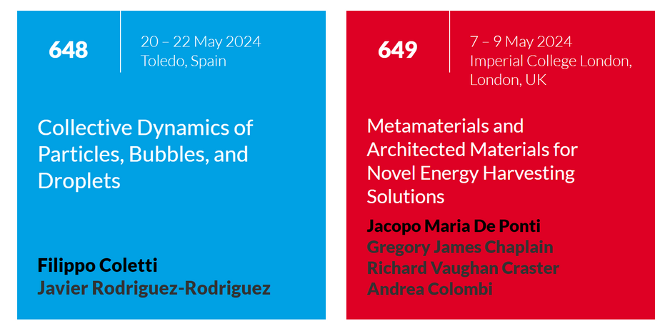
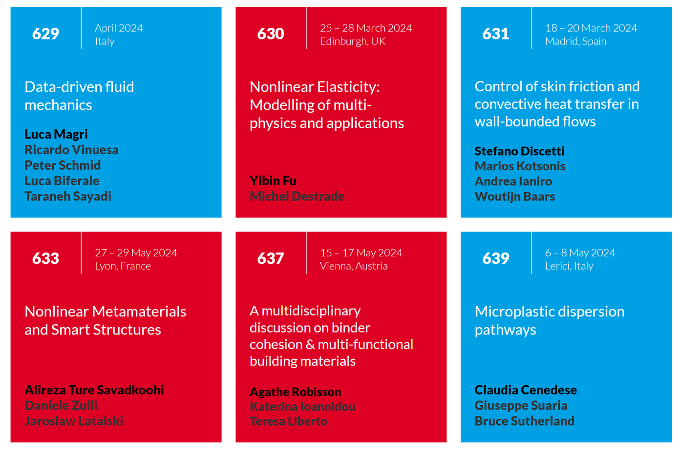
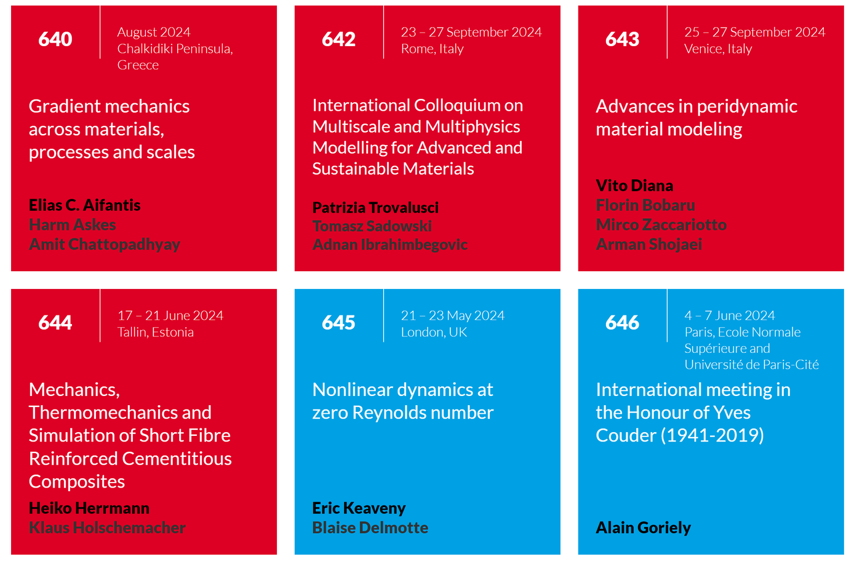
2024
COLLOQUIA

Slide 7

CONFERENCES
broad in scientific scope
300 to 1500 participants
meet and discuss current research on a regular basis
€ 3.000 seed money contribution from EUROMECH
no proceedings necessary
EFDC-European Fluid Dynamics Conference (every 2 years)
EMMC-European Mechanics of Materials Conference (every 2 years)
ENOC-European Nonlinear Dynamics Conference (every 3 years)
ESMC-European Solid Mechanics Conference (every 3 years)

Slide 8
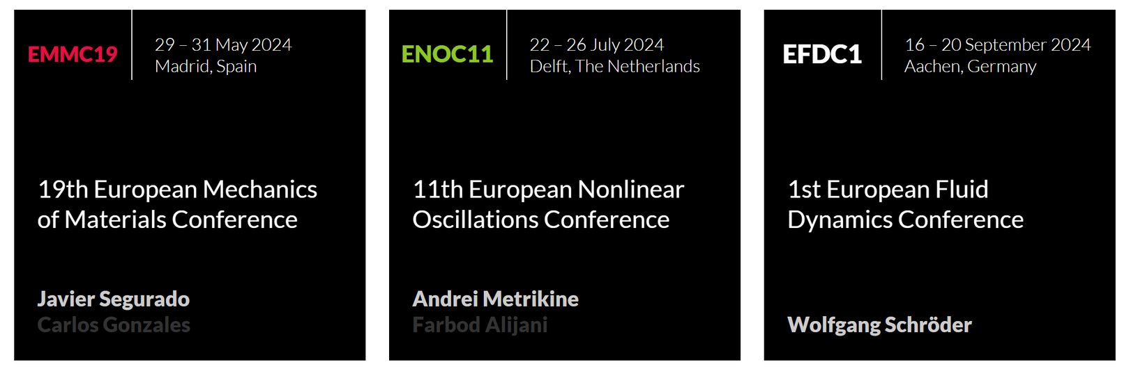
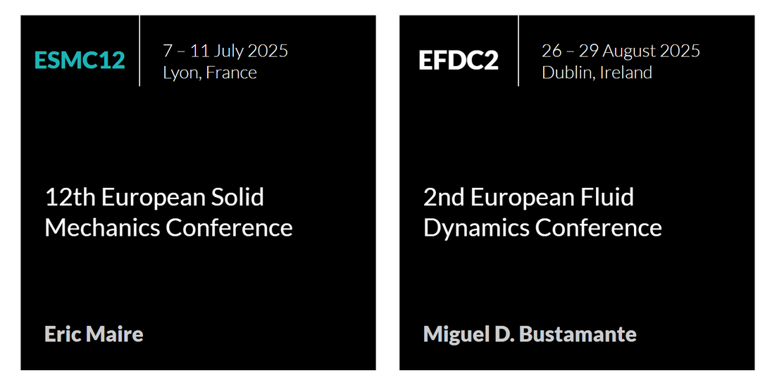
2024
2025
CONFERENCES

Slide 9
AWARDS
2024 Prize in Fluids:
Timothy J. Pedley
2022 Prize in Solids:
Jean-Jacques Marigo
2024 Fellows in Fluids: Dwight Barkley, Eric Lauga, John Tsamopoulos
2022 Fellows in Solids:
Laura De Lorenzis, Vikram Deshpande, Umberto Perego
.
01
02
03
Two «Young Scientist» awards at each conference
Fellows in Fluids/Solids:
members of the Mechanics community who have contributed significantly to the advancement of mechanics and related fields (3 to 5 Fellows every 2 or 3 years).
EUROMECH Prizes in Fluids/Solids:
for outstanding and fundamental research accomplishments in Mechanics (every 2 or 3 years).

Slide 10
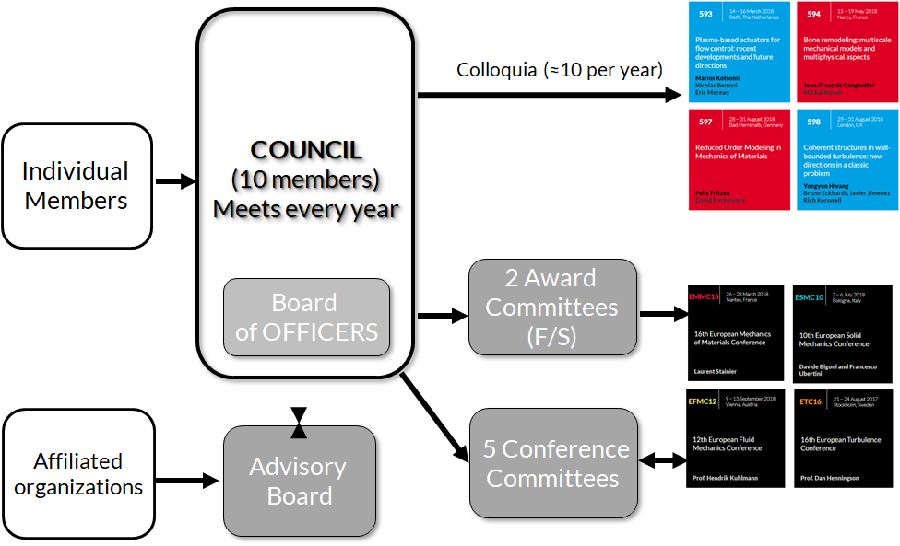
STRUCTURE
COUNCIL
(12 members)
MEETS EVERY YEAR

Slide 11
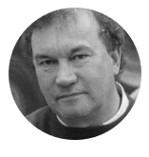
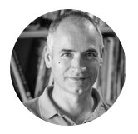
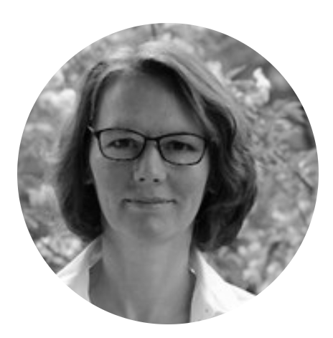
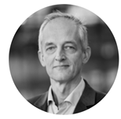
2024
OFFICERS
MARC GEERS
GERTJAN VAN HEIJST
JACQUES MAGNAUDET
KERSTIN WEINBERG
President
Vice President
Secretary General
Treasurer

Slide 12
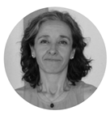
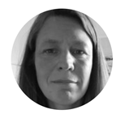
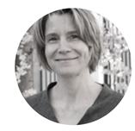
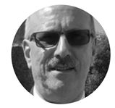
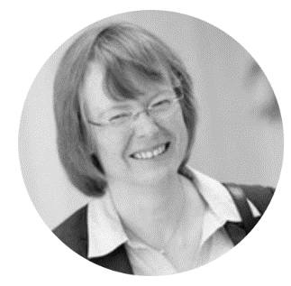
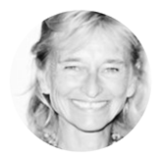
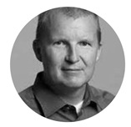
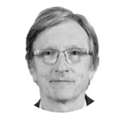
2024
COUNCIL
MARC GEERS
GERTJAN VAN HEIJST
JACQUES MAGNAUDET
KERSTIN WEINBERG
President
Vice President
Secretary General
Treasurer
PILAR ARIZA
ANNE JUEL
ANKE LINDNER
FERNANDO PINHO
STEFANIE
REESE
M. VITTORIA SALVETTI
OLE SIGMUND
GABOR STEPAN

